Slide 1

Medical Insurance Cost Predictor
Final Project Review | Department of CSE | KL University
TEAM MEMBERS
2420030239 – P. Hansini
2420030241 – G. Sreevarsha
Guide: Dr. N. Sunanda | Academic Year: [2026–27]
Notes:
Title slide. Replace all bracketed text. Use the full project title, list every team member with registration number, and name your guide. Insert the institution logo in the dashed box.

Slide 2
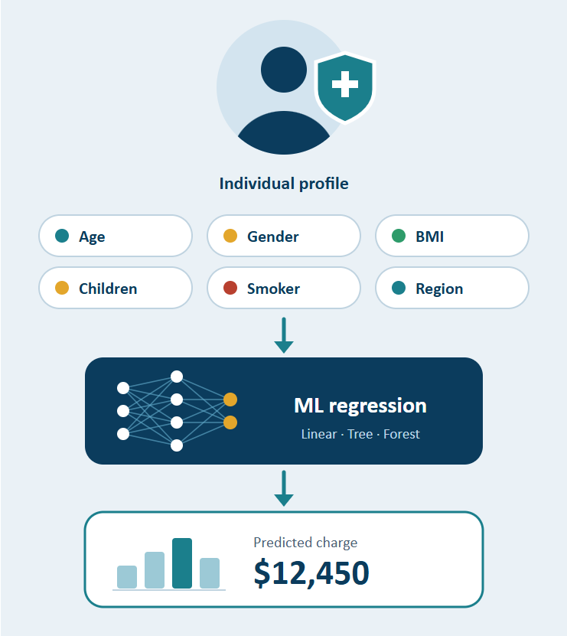



Introduction & Problem Statement
Background
Medical insurance costs differ from person to person. Factors such as age, BMI, smoking status, dependents, gender, and region influence the final charge.
Problem Statement
Manually estimating insurance costs is difficult because many factors affect the final amount. This project uses machine learning and historical insurance data to predict an individual's medical insurance cost.
Motivation / Need
The system helps users estimate expected insurance expenses and helps providers understand cost-related factors. Comparing multiple models helps identify a suitable prediction approach.
Notes:
State the domain, the exact problem and why it matters. Keep it to about 2 minutes. Add one real-world statistic if you can, with a citation.

Slide 3


Objectives & Scope
Objectives
1
Collect and analyze historical medical insurance data to understand the factors affecting insurance costs.
2
Preprocess the dataset by handling missing values, duplicate records, and inconsistent data.
3
Train and compare three machine learning models: Linear Regression, Decision Tree, and Random Forest.
4
Evaluate model performance using MAE, RMSE, and R² score to select the best model for predicting medical insurance costs.
Notes:
Objectives should be measurable and start with action verbs. The scope slide tells the panel what you did and did not attempt.

Slide 4

Literature Survey
S.No | Author(s) & Year | Method / Technique | Key Findings | Limitation / Gap
1 | Khaja Ziauddin & Srikanth Reddy Konni (2020) | Linear Regression | Predicts insurance charges based on input factors. | Limited in capturing complex relationships.
2 | Yaowen Hu (2024) | Decision Tree Regression | Uses feature-based decisions to estimate costs. | May overfit the training data.
3 | Ugochukwu Orji & Elochukwu Ukwandu (2024) | Random Forest Regression | Combines multiple decision trees for prediction. | Requires more computational resources.
4 | Sabarinath U S & Ashly Mathew (2024) | Regression-based ML | Uses historical insurance data to estimate expenses. | Limited comparison of multiple models and influencing factors.
Research Gap
Existing approaches mainly focus on predicting medical insurance costs using individual machine learning techniques.
There is a need for a system that compares multiple regression models, performs proper data preprocessing, analyzes important factors such as age, BMI, and smoking status, and evaluates prediction accuracy using MAE, RMSE, and R² score to select the best-performing model..
Notes:
Summarise four to six relevant papers or existing systems. End with the research gap, because that gap justifies your project.

Slide 5





Proposed System & Methodology
STEP 1
STEP 2
STEP 3
STEP 4
STEP 5
Define Problem
Collect Data
Design
Implement
Test & Evaluate
Collect historical medical insurance data containing age, gender, BMI, children, smoking status, region, and insurance charges.
Preprocess the dataset, perform Exploratory Data Analysis (EDA), and select three regression models for prediction.
Train and implement Linear Regression, Decision Tree Regression, and Random Forest Regression models.
Identify the need to predict medical insurance costs based on personal and lifestyle factors.
[Metrics, test cases and validation]
Key Novelty / Contribution
Our project compares three machine learning regression models to identify the most suitable approach for medical insurance cost prediction. It also analyzes how factors such as age, BMI, and smoking status influence insurance charges.
Notes:
Walk through the five steps left to right. Rename the steps to match your project (for example, Requirement Analysis, Design, Coding, Testing, Deployment). End with your novelty.

Slide 6
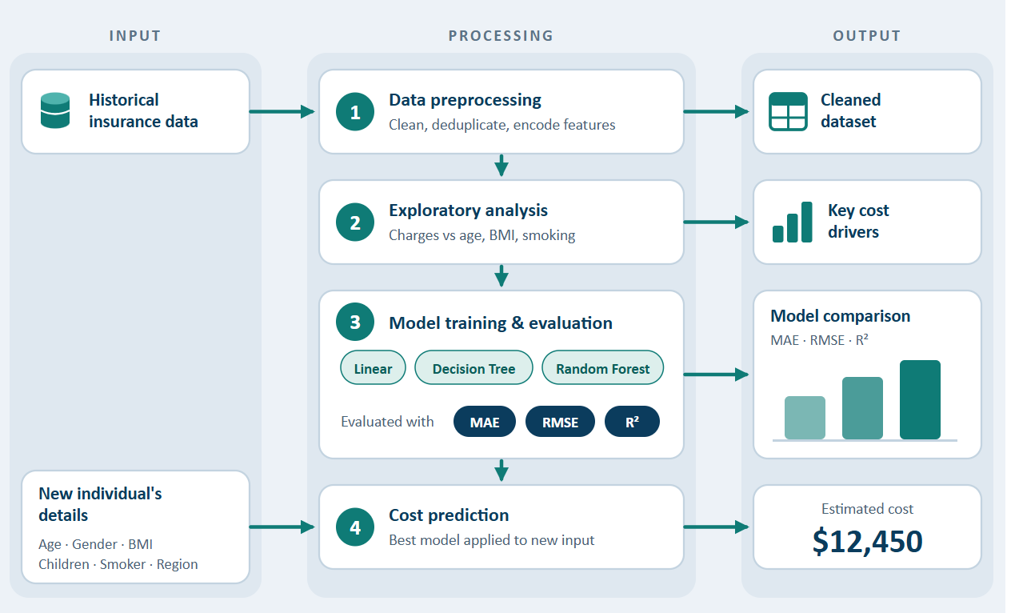
System Architecture
Components
1
Data Preprocessing: Cleans data and encodes features
2
Exploratory Analysis: Finds which factors drive charges
3
Model Training & Evaluation: Compares 3 models via MAE, RMSE, R²
4
Cost Prediction: Estimates cost for a new individual
Notes:
Insert a clear block diagram: input, processing, storage, output. Number each block and explain them on the right. Redraw the figure yourself rather than copying it.

Slide 7


Hardware & Software Requirements
Hardware
Software & Tools
Libraries / Frameworks
Processor: Intel Core i3 or above
RAM: Minimum 4 GB
Storage: Minimum 5 GB free space
GPU: Not required (CPU is sufficient)
Internet connection
Operating System: Windows 10/11
Programming Language: Python 3.x
IDE: VS Code / Jupyter Notebook
Data Handling: Pandas, NumPy
Version Control: Git / GitHub
Scikit-learn – Machine learning models
Pandas & NumPy – Data preprocessing
Matplotlib & Seaborn – Data visualization
Flask – Web application framework
Joblib – Saving trained models
Deployment / Platform: Local Machine – Python-based Flask Web Application
Notes:
List only what you actually used, with versions. For a pure software project, shorten the hardware list and add cloud or deployment resources.

Slide 8
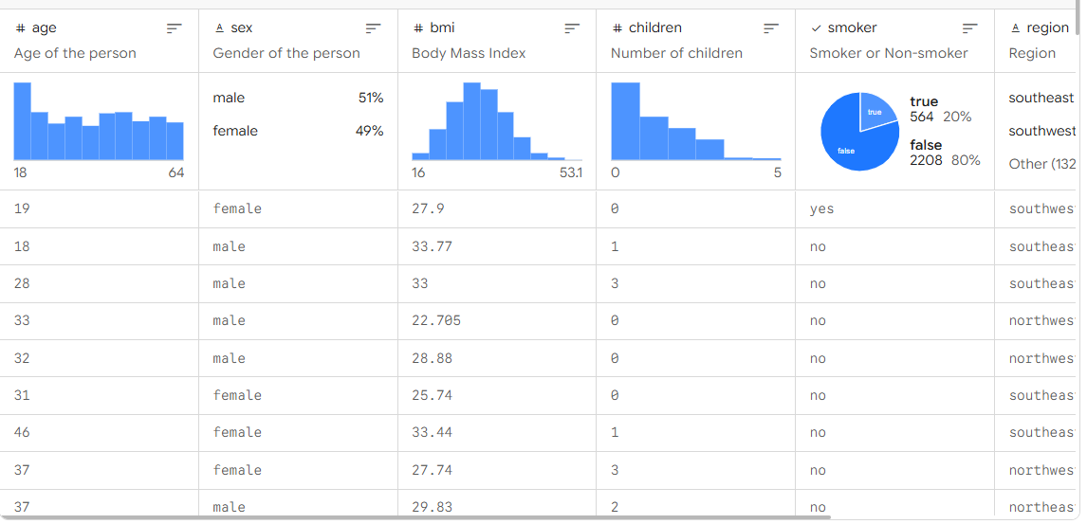
Dataset / Data Understanding
1,338*
7*
Records (rows)
Features (columns)
0*
1
Missing values
Target classes
Source: Kaggle – Medical Cost Personal Dataset.
Features: Age, Sex, BMI, Children, Smoker, Region.
Quality: Check for missing values, duplicate records, and inconsistent data.
Notes:
Explain where the data came from and what it contains. Show a screenshot of the first rows or the info summary. For non-data projects, replace this slide with “Requirement Analysis” or “Input Specification”.

Slide 9
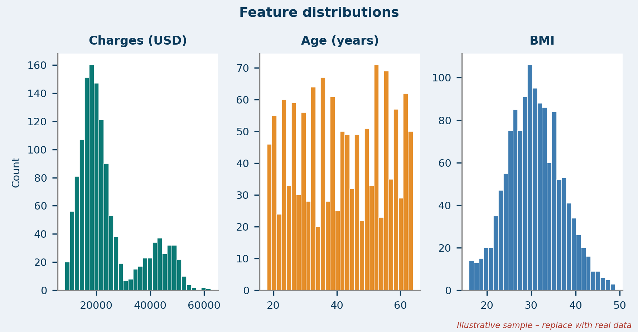
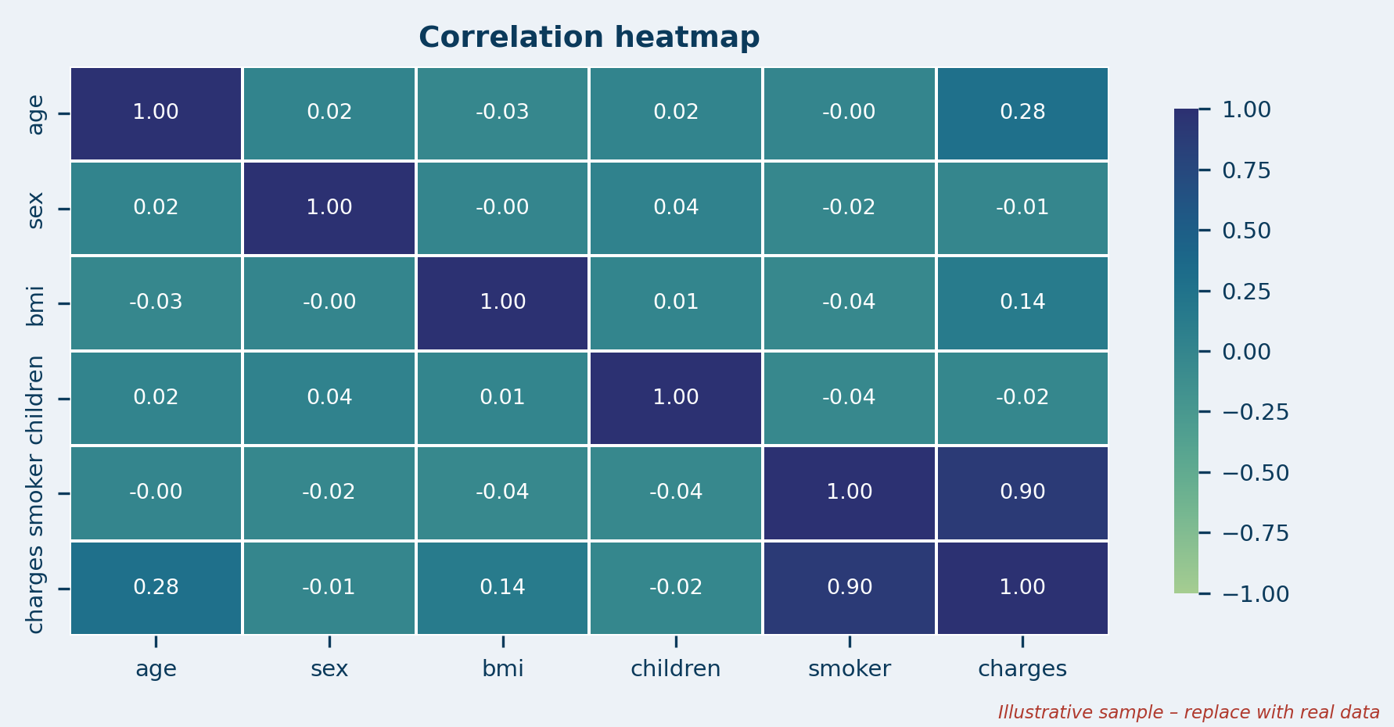



Data Preprocessing & Exploratory Analysis
Cleaning
Transformation
Feature Selection
Missing values, duplicate records and inconsistent data are handled before modelling.
Categorical features (sex, smoker, region) are encoded into numeric form.
Six inputs: age, sex, BMI, children, smoker, region. Target: charges.
Notes:
Show two or three plots that tell a story: distributions, correlations, outliers. Explain what each plot told you and what you did about it.

Slide 10
Module-wise Description
1
Data Preprocessing
2
Exploratory Analysis
Purpose: Clean data and encode features
Input → Output: Raw dataset → clean, encoded data
Developed by: [Team member name]
Purpose: Find which factors drive charges
Input → Output: Clean data → plots, correlations
Developed by: [Team member name]
3
Model Training & Evaluation
4
Cost Prediction
Purpose: Train 3 models; compare MAE, RMSE, R²
Input → Output: Training data → scores, best model
Developed by: [Team member name]
Purpose: Estimate cost for a new individual
Input → Output: Person’s details → predicted cost
Developed by: [Team member name]
Notes:
Divide the project into three to five modules. For each, state its purpose, inputs, outputs and who built it. Duplicate a card if you have more modules.

Slide 11

Algorithms & Technologies Used
Linear Regression
Decision Tree Regression
Random Forest Regression
Why chosen
Simple, interpretable baseline that links input features to insurance charges.
Key parameters
Coefficients (one per feature) and an intercept; minimal tuning.
Why chosen
Captures non-linear patterns through feature-based decisions; easy to visualise.
Key parameters
max_depth, min_samples_split (limit overfitting).
Why chosen
Combines many trees to improve accuracy and reduce overfitting.
Key parameters
n_estimators, max_depth, random_state.
Selection criteria: Lowest MAE and RMSE with the highest R² on the test data.
Notes:
Name each model, algorithm or technology, say why you chose it, and list the key settings. Then explain how you picked the final one.

Slide 12
Implementation / Model Building
Feature Selection
Code snippet / pseudocode
Age, sex, BMI, children, smoker and region – known cost factors. Target: charges.
# Split, preprocess and train 3 models
X_train, X_test, y_train, y_test = \
train_test_split(X, y, test_size=0.2,
random_state=42)
models = {
"Linear Regression": LinearRegression(),
"Decision Tree": DecisionTreeRegressor(),
"Random Forest": RandomForestRegressor(),
}
for name, model in models.items():
pipe = Pipeline([
("preprocess", preprocessor),
("model", model)])
pipe.fit(X_train, y_train)
pred = pipe.predict(X_test)
Preprocessing Pipeline
Remove duplicates, handle missing or inconsistent values, encode categorical features.
Data Splitting
80% training / 20% testing split of the 1,338 records.
Configuration
random_state = 42 for a reproducible split; all models compared on the same test set.
Notes:
Describe the build in the order you did it. Paste only the most important code or pseudocode, not entire files. For hardware projects, show the circuit or wiring summary instead.

Slide 13
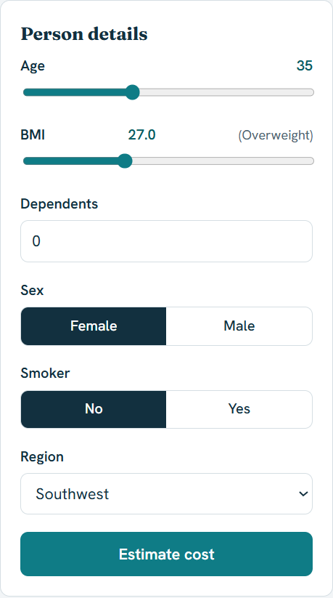
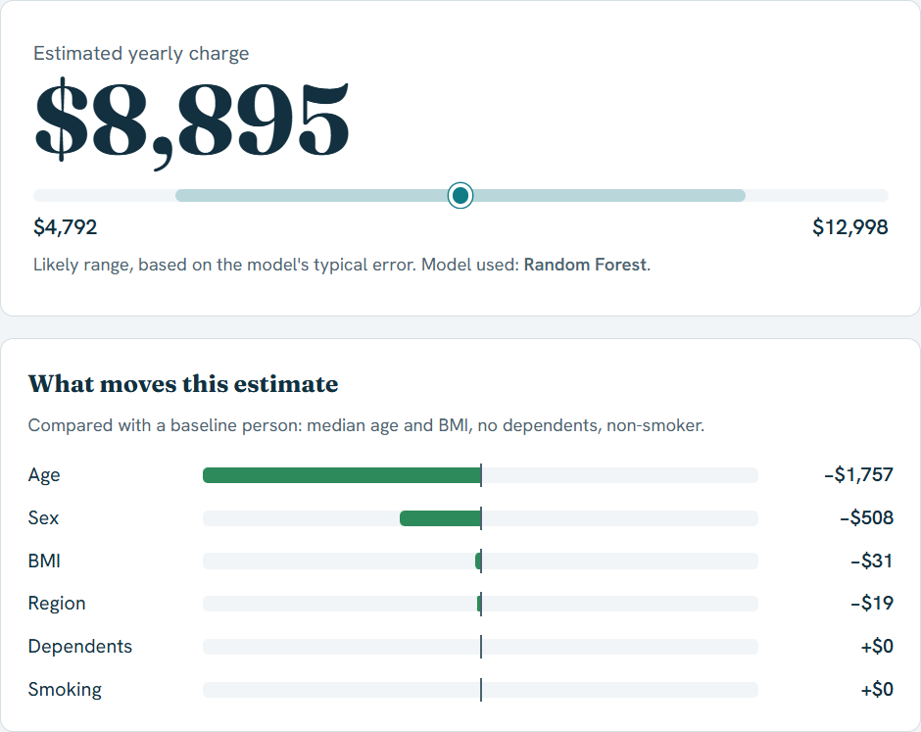
Working Prototype / Output Screens
Input Form
User enters age, BMI, dependents, sex, smoker and region.
Prediction Result & Factor Impact
Estimated yearly charge with a likely range (Random Forest), and how each factor moves the estimate.
Notes:
Show real screenshots, photos of the hardware or a short demo video link. Caption each one with what the viewer should notice.

Slide 14
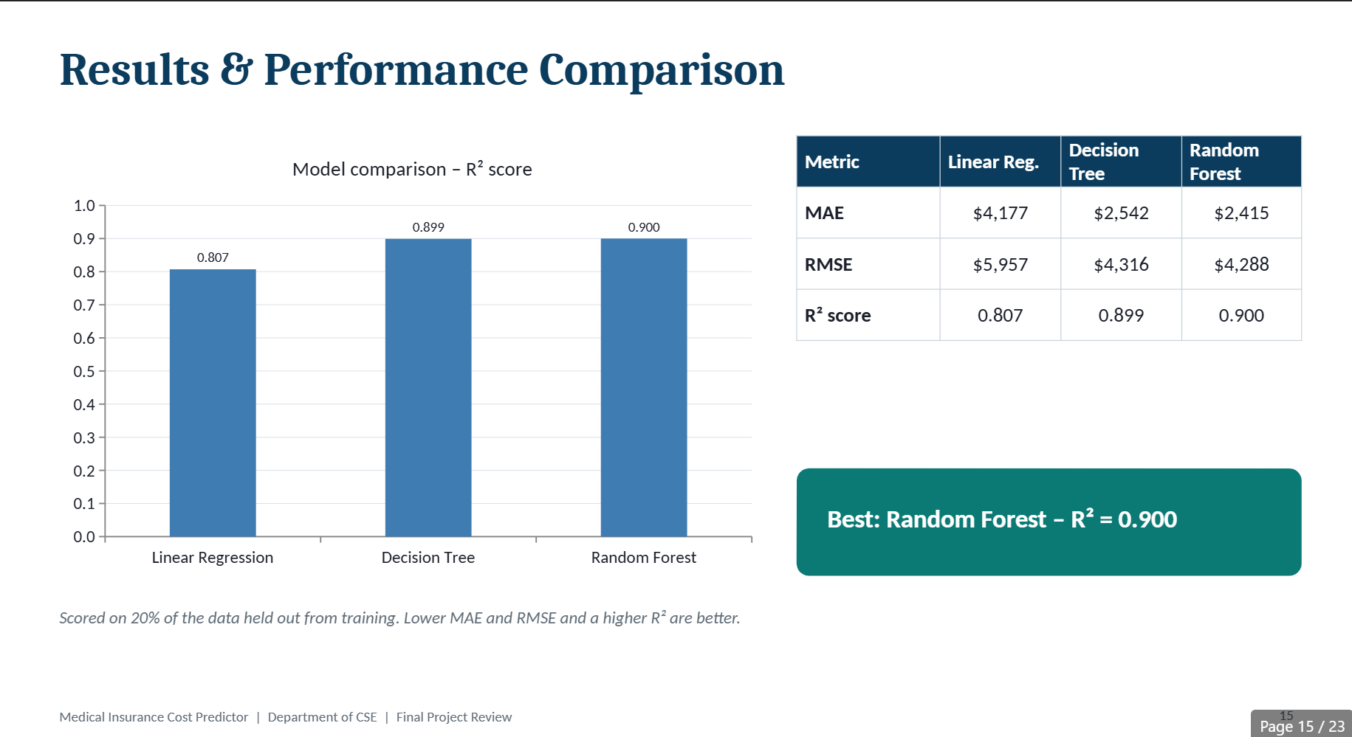
Results & Performance Comparison
Metric | Linear Reg. | Decision Tree | Random Forest
MAE | — | — | —
RMSE | — | — | —
R² score | — | — | —
Best: Random Forest – R² = [value]
Chart shows 0 and table shows “—” until you enter your results (right-click chart → Edit Data).
Notes:
Right-click the chart and choose Edit Data to enter your real numbers. Replace the metrics with the ones that fit your project (accuracy, latency, power, throughput, user rating). State clearly which option performed best.

Slide 15
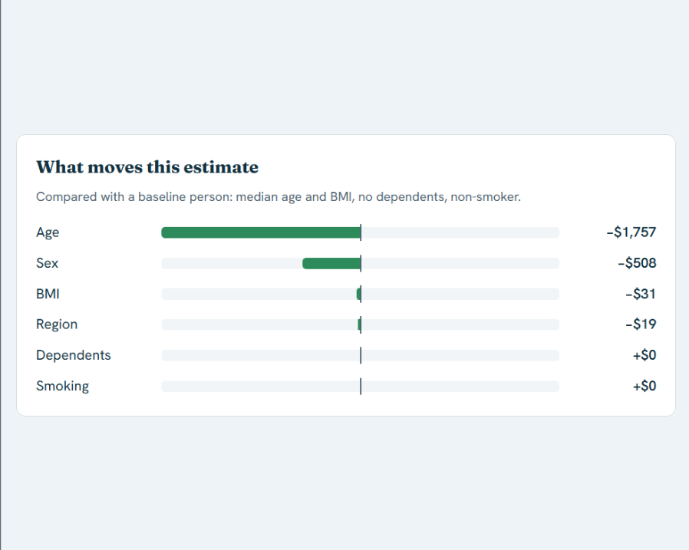
Analysis & Key Findings
$8,895
Best R² score, achieved by Random Forest
Interpretation: [What the R², MAE and RMSE values mean]
Error analysis: [Where predictions deviate from actual charges]
Key drivers: [Confirm from feature importance – e.g. smoker, age, BMI]
Notes:
Explain what the numbers mean. Use a confusion matrix, ROC curve, feature-importance chart or output comparison. Be honest about weak results; panels value that.

Slide 16

Testing & Validation
Test ID | Test Description | Expected Result | Actual Result | Status
TC-01 | Load the dataset and check its shape | 1,338 rows and 7 columns | [Observed output] | [Pass / Fail]
TC-02 | Clean data: check missing and duplicate values | No missing or duplicate records remain | [Observed output] | [Pass / Fail]
TC-03 | Train the 3 models and compute MAE, RMSE, R² | Scores produced for every model | [Observed output] | [Pass / Fail]
TC-04 | Predict cost for a new individual’s input | A single numeric charge is returned | [Observed output] | [Pass / Fail]
Functional Testing
Validation Method
Performance Testing
Checks on data loading, preprocessing, training and prediction steps.
Hold-out validation: 80% training, 20% testing split.
Model accuracy compared using MAE, RMSE and R² score.
Notes:
List representative test cases with expected and actual outcomes. Name the validation methods you used. Delete rows you do not need.

Slide 17


Challenges & Limitations
Challenges Faced
Limitations
Missing, duplicate and inconsistent records → cleaned during preprocessing
Categorical features (sex, smoker, region) → encoded as numeric values
Choosing the best of three models → compared using MAE, RMSE and R²
Small dataset (1,338 records) limits generalisation
Only six input features; no medical history or claim data
Runs on a local machine; not yet deployed online
Notes:
Be candid. Pair every challenge with how you solved it, and list limitations that the panel would otherwise spot themselves.

Slide 18

Conclusion
Built an ML system that predicts medical insurance cost from age, sex, BMI, children, smoker and region, using the Kaggle dataset of 1,338 records.
1
Final Outcome
[Key result: best model, its R², MAE and RMSE, and how it compares with the other two models]
[XX%]
2
[Headline metric, e.g. R² of best model]
Objectives achieved: [x of 4]
Helps users and insurers estimate expected costs and see which factors, such as age, BMI and smoking, drive them.
3
Notes:
Revisit each objective and say whether you met it. Quote your headline result with numbers. Do not introduce new material here.

Slide 19



Future Scope & Applications
Improve Performance
Hyperparameter tuning and models such as Gradient Boosting or XGBoost.
Applications
Premium estimation for insurance providers
Cost planning for individuals
Research on factors affecting insurance cost
Adopters: insurers, policyholders, researchers
Expand Data / Features
Larger datasets and more features, such as medical history and lifestyle.
Deploy & Build an Interface
Host the Flask web app online with a user-friendly interface or API.
Scale & Secure
Cloud deployment with data privacy and reliable performance.
Notes:
Give concrete next steps, ideally tied to the limitations. Then name two or three real-world uses.

Slide 20
Team Contribution
Reg. No. | Name | Contribution / Modules Handled
2420030239 | P. Hansini | Data Preprocessing, EDA & Factor Analysis, literature survey, testing.
2420030241 | G. Sreevarsha | Model Training & Evaluation, Cost Prediction Interface, architecture diagram.
Notes:
Show that work was planned and shared. Every member should be able to explain their own module.

Slide 21

References
[1] K. Ziauddin and S. R. Konni, “Utilizing machine learning to determine the cost of medical insurance,” Turkish J. Comput. Math. Educ. (TURCOMAT), vol. 11, no. 3, pp. 2849–2852, Dec. 2020.
[2] Y. Hu, “[Add paper title and venue],” 2024.
[3] U. Orji and E. Ukwandu, “Machine learning for an explainable cost prediction of medical insurance,” Mach. Learn. Appl., vol. 15, Art. no. 100516, 2024.
[4] U. S. Sabarinath and A. Mathew, “Medical insurance cost prediction,” Int. J. Data Commun. Netw., vol. 4, no. 4, pp. 1–4, Jun. 2024.
[5] M. Choi, “Medical Cost Personal Datasets,” Kaggle. [Online]. Available: https://www.kaggle.com/datasets/mirichoi0218/insurance
[6] F. Pedregosa et al., “Scikit-learn: Machine learning in Python,” J. Mach. Learn. Res., vol. 12, pp. 2825–2830, 2011.
Project Links
GitHub: https://github.com/Hansini239/KLH-CSE-2026-27-2420030239-Medical-Insurance-Cost-Predictor
Dataset: kaggle.com/datasets/mirichoi0218/insurance
Notes:
Use IEEE style, numbered in order of first citation in the deck. Include datasets, documentation and code repositories.

Slide 22
THANK YOU
Questions & Discussion
Guide: Dr. N. Sunanda | Department of CSE, KL University
Notes:
Leave this slide up during questions. Make sure every team member can answer questions about their own module.

